Slide 1
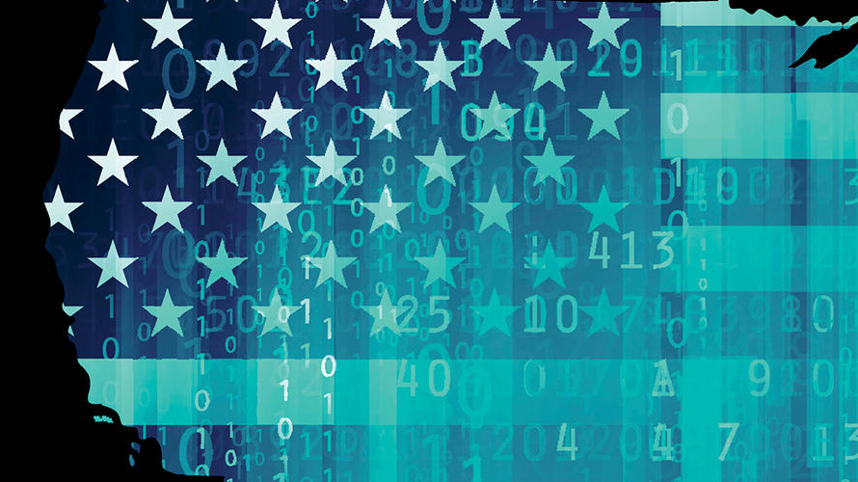
Information Assurance Compliance
Dawn Inman
CYB-348-Z1

Slide 2

Information Assurance
According to the U.S. Government, information assurance includes five pillars of protection:
Integrity
Availability
Authentication
Confidentiality
Nonrepudiation
(“Information Assurance (IA)”, 2019)
The NIST defines information assurance as the act of protecting and defending information and information systems. (“Information Assurance”, 2019)
Techtarget defines information assurance as protecting from and managing risk that is possible from “the use, storage and transmission of data and information systems.” (Rouse, 2014)

Slide 3

U.S. Laws for Information Assurance Compliance
Gramm-Leach-Bliley Act
Sarbanes-Oxley Act of 2002
Health Insurance Portability and Accountability Act (HIPAA)
Family Educational Rights and Privacy Act (FERPA)
EU General Data Protection Regulation (GDPR)

Slide 4

Gramm-Leach-Bliley Act
Known as the Financial Modernization Act of 1999
It is meant to protect consumer financial privacy.
Applies to businesses that provide financial products or services like banks, credit reporting agencies, insurance, investments, etc. (De Groot, 2019)
Requires safeguarding sensitive data and an explanation to customers about information-sharing practices.
Enacted to repeal part of the Glass-Steagall Act of 1933, allowing consolidation of banking, securities and insurance, as well as provide new rules that require privacy notices and opt out options. (McAfee, 2019)

Slide 5

Gramm-Leach-Bliley Act
Penalties
Financial Institutions can be fined $100,000 for each violation.
Individuals can be fined $10,000 for each violation
Individuals can be imprisoned for up to 5 years. (De Groot, 2019)
How is non-compliance discovered?
Most times non-compliance is found after an information breach.
Consumers report the privacy issues to the FTC.
New software tested in Europe may bring about an online enforcement tracker for the U.S. (Rakesh, 2019)
Enforcement by FTC, state insurance oversight agencies, federal banking agencies and federal regulatory agencies.
Several of those fined for not following the law.
Venmo (Paypal affiliate)
TaxSlayer
Equifax
Paulson & Nace, PLLC.

Slide 6

Gramm-Leach-Bliley Act
Financial Privacy Rules Compliance
Safeguards Rules
Provide each consumer with a privacy notice at consumer relationship establishment and annually afterward.
Explain what information is collected, where it’s share, how it’s used and how it’s protected.
Give an opt out of information sharing
Develop a written information security plan including process and procedures for protecting information.
Construct a thorough risk analysis for each department that handles the information.
Develop, monitor and test the programs to make the information as secure as possible.
Changes in any area must be tested as well.
(McAfee, 2019)

Slide 7

Gramm-Leach-Bliley Act
Information Security Plan Compliance
Designate employees to coordinate information security program
Assess and Identify Risk in all areas and evaluate current safeguards for effective control of these risks.
Design, Implement, Monitor and Test a Safeguards program.
Choose Vendors and Service Providers that maintain safeguards as a contract requirement and oversee their handling of customer information
Evaluate and Adjust the program as circumstances change, including organizational changes or security and monitoring needs and changes
To remain GLBS compliant, attention needs to be paid to employee management and training, security management, information systems, information security plans (safeguards) and implementation. (FTC, 2006)

Slide 8

Sarbanes-Oxley Act of 2002
Named after Senator Sarbanes, D and Congressman Oxley, R.
Designed to target Corporate Fraud
Established financial and auditing regulations for Public Companies.
Created to Protect the Public, Employees and Shareholders from Fraudulent Financial Actions and Accounting Errors. (Rouse, 2018)
Created the Public Company Accounting Oversight Board
Banned Company loans to Executives
Gives Job Protection to Whistleblowers (Amadeo, 2019)
Applies to Publicly Traded Companies in the U.S. including wholly-owned subsidiaries, Publicly Traded Non-U.S. Companies doing business in the U.S. and Private Companies Preparing their Initial Public Offering.

Slide 9

Sarbanes-Oxley Act of 2002
Penalties
How is Non-Compliance Discovered?
Several of those fined for not following the Law.
Lawsuits
Negative Publicity
Fines up to $1 million and 10 years in prison for mistakes.
Fines up to $5 million and 20 years in prison for purposely submitting inaccurate certifications
Corporations can be fined up to $10 million and receive 30 years in prison for not complying with OFAC (Compliance Guidelines, 2019)
Individuals can fill out a SAR (Suspicious Activity Report.) if they suspect an individual. It is a requirement if suspected and they are on the OFAC list.
Internal Controls
Whistleblower
Enforcement by OFAC (Office of Foreign Assets Control, Department of U.S. Treasury)
Xerox
Citicorp
JPMorgan
Chase
Barclays
Royal Bank of Scotland
UBS (Bobelian, 2015)

Slide 10

Sarbanes-Oxley Act of 2002
SOX Compliance Requirements
SOX Compliance Audits
Responsibility for financial reports and internal controls falls on the CEO and CFO
Internal Control Report for financial records reported to management chain
Data Security Policies enforced to protect data.
Documentation proving SOX compliance is updated and maintained.
Yearly Audits including those from independent auditors easily available for stakeholders.
Verification of Financial Statements (Petters, 2019)

Slide 11

Sarbanes-Oxley Act of 2002
SOX Compliance of Internal Controls and Data Security
Access-secure locations, passwords, lockout screens and other data security measures organization wide.
Security-Manage risk, preventing breaches and timely remediation of incidents to monitor and protect the financial database.
Change Management-Adding and updating software and hardware, databases while keeping accurate records of all change information.
Backup Procedures-All organization information uses the same SOX compliance requirements no matter where it’s stored or used. (Murphy, 2016)

Slide 12

Health Insurance Portability and Accountability Act (HIPAA)
Created to:
Protect Individuals who change Jobs from loss of Health Insurance Coverage.
Prevent Refusal of Coverage for Pre-existing Conditions.
Enforce Compliance to the Privacy Regulations set by HHS. (eVisit, 2018)
Signed in 1996 to provide Health Insurance Portability between Jobs and Security Provisions for Data Privacy Regarding Medical Information.

Slide 13
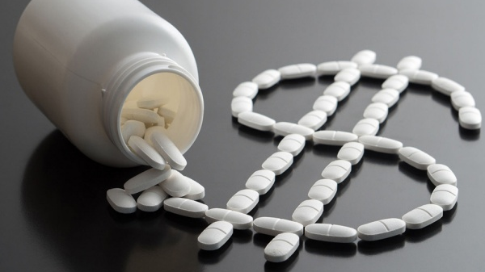
Health Insurance and Portability Accountability Act (HIPAA)
Penalties
$100-$50,000 per violation based on level of negligence.
Reasonable Cause does not involve jail time.
Willful Neglect can result in criminal charges.
How is Non-compliance Discovered?
Individuals can file a complaint with the Office for Civil Rights (OCR)
File Electronically through the OCR Complaint Portal or in Writing
Instructions are through HHS at
https://www.hhs.gov/hipaa/filing-a-complaint/index.html
Enforcement by Office for Civil Rights
Those fined in 2019 for Non-Compliance
Sentara Hospitals
Texas Health and Human Services Commission
University of Rochester Medical Center
Jackson Health System
Elite Dental Associates
Bayfront Health St. Petersburg
Indiana Medical Records
Touchstone Medical Imaging
Cottage Health

Slide 14

Health Insurance Portability and Accountability Act (HIPAA)
Who needs to be HIPAA Compliant?
Health Plans
Health Care Clearinghouses
Health Care Providers
Business Associates (Newtek, 2019)
Protected Information Includes:
Any information that can identify an individual and was created and used during the process of health care.
Any conversations about treatment
Billing information
Medical information in the insurance database.

Slide 15

Health Insurance Portability and Accountability Act (HIPAA)
Encrypt Protected Health Information (PHI) both in rest and transit
Authorized Medical Professionals must have a “Unique User Identifier” for monitoring access and communication
All Technology must have Automatic Log-off to prevent Unauthorized Access on Unattended Devices (HIPAA Journal, 2019)
HIPAA Requirements are Extensive and Professional Organizations can be hired to check for total Compliance.

Slide 16

Family Educational Rights and Privacy Act (FERPA)
Federal Law that Provides:
Parental Rights for Education Records Access of their Children
Rights to Amend Records
Right of Certain Controls over Personal Identity Disclosure from Educational Records
Created due to Evidence that Student Records were being misused across the U.S. in an effort to safeguard the data files of student and parent information. (U.S. Dept of Education, 2019)

Slide 17

Family Educational Rights and Privacy Act (FERPA)
Penalties
Possible Forfeiture of Federal Funding.
Some States allow for Monetary Damages for Private Information Disclosure. (Hlavac, 2015)
How is non-compliance discovered?
Individuals can file a complaint via email or mail.
Enforced by the Family Policy Compliance Office with the Department of Education
The DOE publishes binding Rules for FERPA
DOE is the only enforcement action available for Remediation (SPLC, 2018)
FERPA speaks only to the Secretary of Education and fails to confer enforceable rights for individuals. (McGlamery, 2002)

Slide 18

Family Educational Rights and Privacy Act (FERPA)
Applicable to all Educational Institutions that receive Federal Funding.
This includes all Public Schools, Charter Schools and most Private Schools.
Upon Request, a Parent or Student over 18 must be allowed:
Inspection of that students records
To Amend the Educations records as necessary
The right of controls over Personal Identity Information.
(SPLC, 2018)

Slide 19

Family Educational Rights and Privacy Act (FERPA)
Protection for Students while using online educational services
Identity Authentication of Students
Email Privacy for Students
Data and Information Security, Storage, Retrieval and Disposal.
(U.S. Dept of Education, 2018)

Slide 20
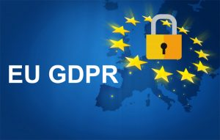
EU General Data Protection Regulation
The Primary Law Regulating how Companies Protect EU citzens’ personal data.
Require consent for data processing
Anonymizing collected data for Privacy Protection
Notifications of Data Breaches
Safe Handling of Data Transfer across Borders.
Some companies will need to appoint Data Protection Officers to oversee compliance. (De Groot, 2019)
Created to prevent companies (such as Cambridge Analytica) from swaying public opinion using data analysis as well as general data point security.

Slide 21
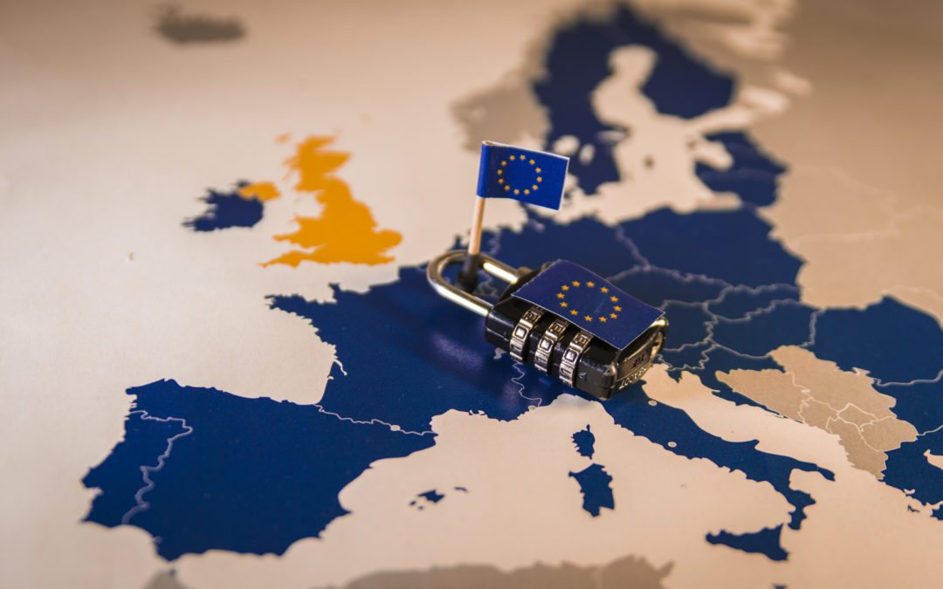
EU General Data Protection Regulation
How is Non-compliance Discovered?
Insider discovery needs to Notify the ICO within 72 hours
European Data Protection Board
Enforced by ICO (Information Commissioner’s Office)
Penalties
Warnings
Impose a ban on data processing
Ordering rectification or erasure of data
Suspending data transfers to third countries.
Lower level offenses merit fines of 10 million Euros or two percent of annual worldwide revenue.
Serious offenses may receive fines of 20 million Euros or four percent of Annual Revenue.
Companies that received fines due to non-compliance.
AggregateIQ Data Services Ltd
Google
British Airways
Marriott International
National Revenue Agency BGN (ITGovernance, 2019)

Slide 22

EU General Data Protection Regulation
Impacts all Businesses where Data Processing is part of the good or services they offer, no matter where the business is located worldwide
The Six Principles to comply with are:
Lawfulness, Fairness and Transparency-with Data Subject
Purpose Limitations- data is limited to immediate purpose
Data Minimization-only what is needed for the purpose
Accuracy-kept current and accurate
Storage Limitation-do not keep it longer than required for it’s purpose
Integrity and Confidentiality-Data Security (Magalhaes, 2018)

Slide 23
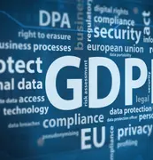
EU General Data Protection Regulation
Identify the Data the Organization Processes with a Data Flow Map
Data Items, Formats, Transfer Methods and Locations
Perform a Risk Assessment
Treat Risks by:
Avoid- Eliminate all risk
Modify- Apply Security Controls
Share- Third Party such as Insurance
Retain- If Risk is low or within acceptable levels
(Irwin, 2018)

Slide 24

References
Amadeo, Kimberly. (October 27, 2019). Four ways Sarbanes-Oxley stops corporate fraud. The Balance. Retrieved from https://www.thebalance.com/sarbanes-oxley-act-of-2002-3306254
Bobelian, Michael. (May 20, 2015). $5.6 B in fines against major banks seems like a lot. Here’s why it won’t deter corporate crime. Forbes. Retrieved from https://www.forbes.com/sites/michaelbobelian/2015/05/20/will-another-record-breaking-payout-reduce-corporate-crime/#418b9c4d2af7
Compliance Guidelines. (December 2, 2019). Sarbanes Oxley (SOX) compliance. Retrieved from https://complianceguidelines.com/sox-compliance.htm
De Groot, Juliana. (December 2, 2019). What is the General Data Protection Regulation? DataInsider. Retrieved from https://digitalguardian.com/blog/what-gdpr-general-data-protection-regulation-understanding-and-complying-gdpr-data-protection
De Groot, Juliana. (July 15, 2019). What is GLBA compliance? Understanding the data protection requirements of the Gramm-Leach-Bliley Act in 2019. Data Insider. Retrieved from https://digitalguardian.com/blog/what-glba-compliance-understanding-data-protection-requirements-gramm-leach-bliley-act
eVist. (May 26, 2018). What is HIPAA and what does it regulate? Retrieved from https://evisit.com/resources/what-is-hipaa/
FTC. (April, 2006). Financial institutions and customer information: complying with the safeguards rule. Retrieved from https://www.ftc.gov/tips-advice/business-center/guidance/financial-institutions-customer-information-complying
HIPAA Journal. (2019). The use of technology and HIPAA compliance. Retrieved from https://www.hipaajournal.com/the-use-of-technology-and-hipaa-compliance/
Hlavac, George & Easterly, Edward. (April 1, 2015). FERPA primer: The basic and beyond. NACE. Retrieved from https://www.naceweb.org/public-policy-and-legal/legal-issues/ferpa-primer-the-basics-and-beyond/
Information Assurance. (2019). I.T. Governance. Retrieved from https://www.itgovernanceusa.com/information/information-assurance
Information Assurance. (2019). NIST. Retrieved from https://csrc.nist.gov/glossary/term/information-assurance
Irwin, Luke. (April 24, 2018). A closer look at the GDPR’s technical requirements. IT Governance. Retrieved from https://www.itgovernanceusa.com/blog/a-closer-look-at-the-gdprs-technical-requirements
IT Governance. (2019). GDPR penalties and fines. Retrieved from https://www.itgovernance.co.uk/dpa-and-gdpr-penalties
Magalhaes, Monique. (January 23, 2018). The 6 GDPR privacy principles you must know – now. TechGenix. Retrieved from http://techgenix.com/6-gdpr-privacy-principles/
McAfee. (2019). Overview of the Gramm-Leach-Bliley Act. Retrieved from https://www.skyhighnetworks.com/cloud-compliance/glba-compliance-requirements/
McGlamery, Jeanette. (October 17, 2002). United States: Students do not have the right to sure for violations of FERPA. Mondaq. Retrieved from http://www.mondaq.com/unitedstates/x/18289/Human+Resources/Students+Do+Not+Have+the+Right+to+Sue+for+Violations+of+FERPA
Murphy, Rich. (November 7, 2016). SOX Compliance Requirements. CyberShark. Retrieved from https://www.blackstratus.com/sox-compliance-requirements/
Newtek. (February 6, 2014). Does your business need to be HIPAA-complaint? Forbes. Retrieved from https://www.forbes.com/sites/thesba/2014/02/06/does-your-business-need-to-be-hipaa-compliant/#5090eca93d7c
Petters, Jeff. (May 21, 2019). What is SOX compliance? Everything you need to know in 2019. Varonis. Retrieved from https://www.varonis.com/blog/sox-compliance/
Rakesh, Soni. (October12, 2019). Are you ready for America’s data protection laws? Venturebeat. Retrieved from https://venturebeat.com/2019/10/12/are-you-ready-for-americas-data-protection-laws/
Rouse, Margaret. (August, 2014). Information assurance. Techtarget. Retrieved from https://searchcompliance.techtarget.com/definition/information-assurance
Rouse, Margaret. (May, 2018). Sarbanes-Oxley Act (SOX). Techtarget. Retrieved from https://searchcio.techtarget.com/definition/Sarbanes-Oxley-Act
SPLC (Student Press Law Center). (2018). FERPA: What it means and how it works. Retrieved from https://splc.org/ferpa-what-it-means-and-how-it-works/
U.S. Department of Education. (2018). Privacy: privacy technical assistance center. Office of Educational Technology. Retrieved from https://tech.ed.gov/privacy/
U.S. Department of Education. (2019). What is FERPA. Retrieved from https://studentprivacy.ed.gov/faq/what-ferpa

